Slide 1


HEART DISEASE PREDICTION
Shreya Jain

Slide 2

Agenda
Key messages
Summary
Introduction
Dataset Overview
Data Variables
Problem Statement
Valuable Insights
Model Comparison
Modelling Recommendation
Interpretation and Conclusion
Future Recommendation

Slide 3
Key messages
Risk factors for heart disease include a variety of medical disorders, your lifestyle, your age, and your family history.
Some risk factors, including age or family history, cannot be changed. But by altering the variables under your control, you can reduce your risk.
Obesity, smoking, high cholesterol, and blood pressure are major risk factors for heart disease.

Slide 4
Summary
Consuming a diet heavy in cholesterol, trans fats, and saturated fats.
Getting insufficient exercise.
Alcohol consumption in excess can increase blood pressure readings.
The risk of heart disease and heart attacks rises with tobacco usage.

Slide 5
Introduction
According to the World Health Organization, heart disease kills 12 million people annually.
As it results in death without any overt symptoms, heart disease is sometimes known as the "silent killer.“
Analysing patient data is essential for detecting heart disease in its early stages.
Factors that most affect a person's likelihood of acquiring heart disease should be looked into and identified.

Slide 6
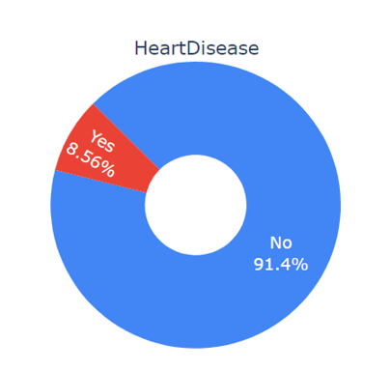
Dataset Overview
CDC (Center for Disease Control and Prevention) survey data 2020.
Total 18 variables with 319795 entries.
Imbalanced data – 8.56% having Heart Disease.
Performed Oversampling.
No null values.

Slide 7

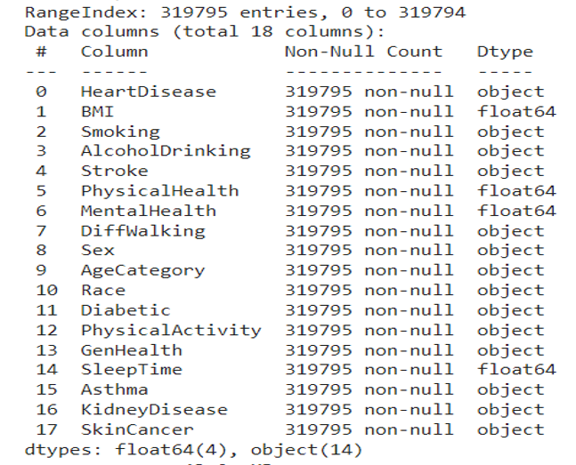
Data variables

Slide 8

Problem Statement
Finding a heart problem is the biggest challenge.
Routine basic health checkup is required.
People with heart disease or those who are at high risk for getting it need early detection and treatment.
Enhancing overall healthcare and reducing the amount of heart-related deaths.

Slide 9

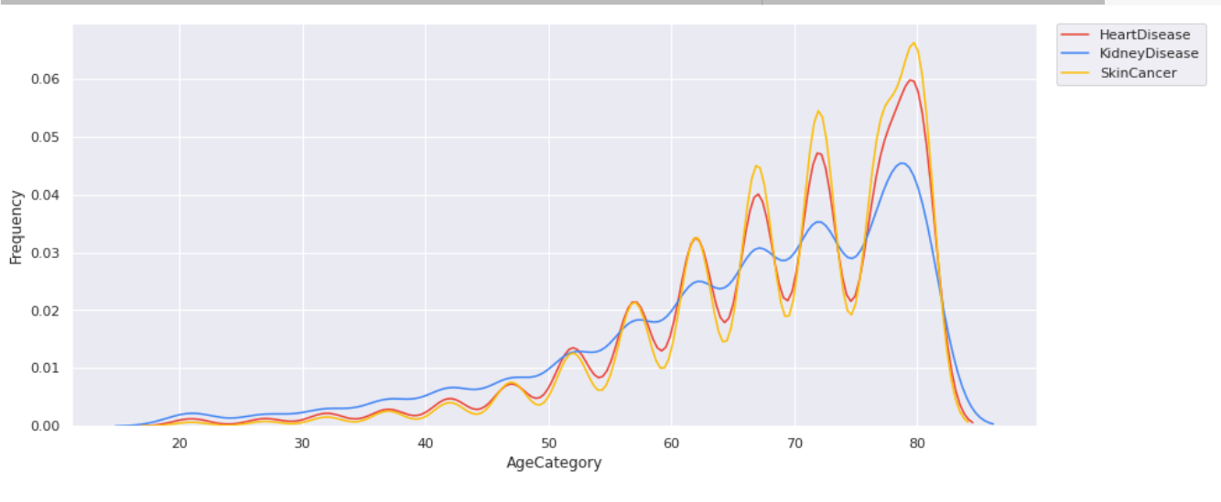

Insights

Slide 10
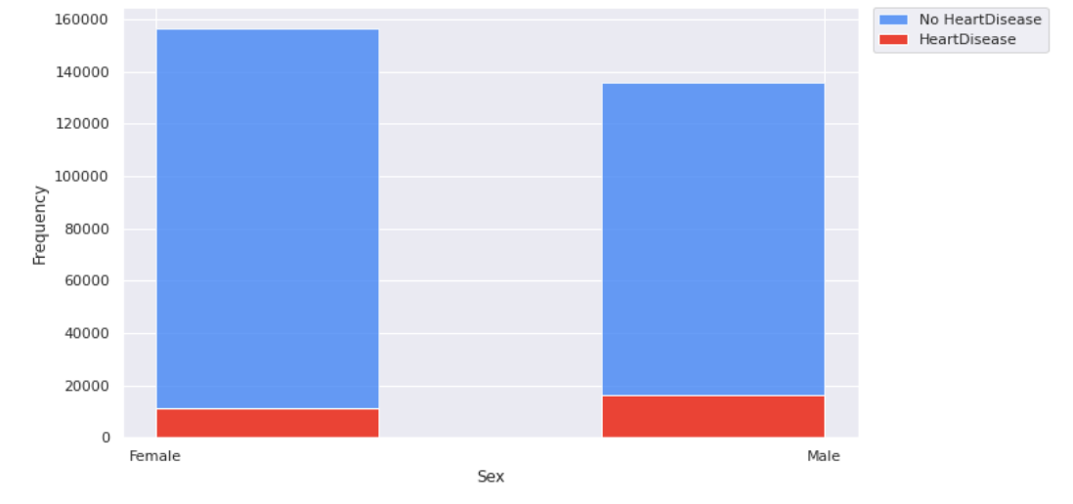
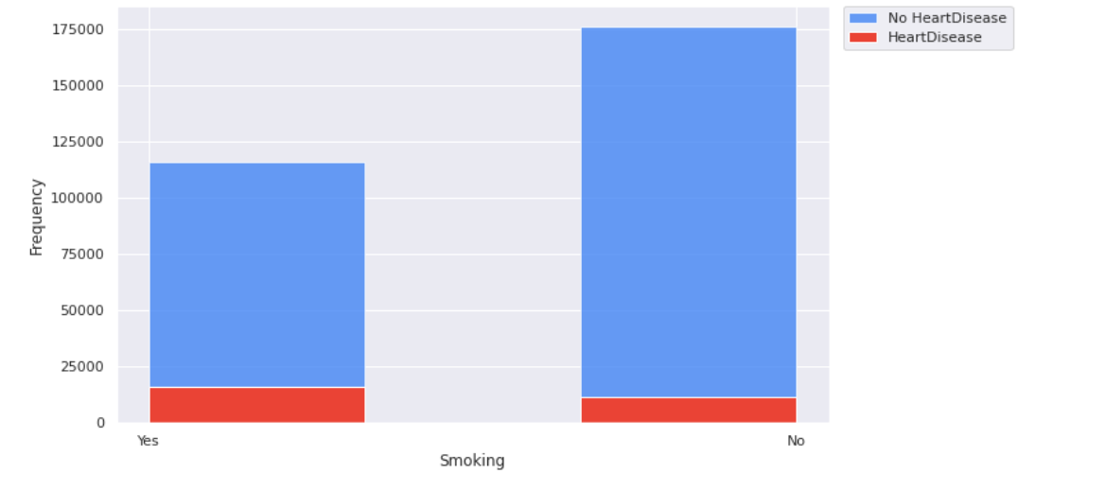
Valuable Insights

Slide 11
Model Comparison
 | Logistic regression | Decision tree | Random forest | XG Boost
Accuracy | 76.5% | 89.01% | 91.9% | 86.73%
F1 score | 77.1% | 89.03% | 91.93% | 86.58%
ROC curve | 84.01% | 89.07% | 96.92% | 95.01%
Precision | 75.2% | 88.86% | 91.55% | 87.59%
Recall | 79.1% | 89.20% | 92.32% | 85.59%
F1 score – The rate of performance of model.
ROC curve – Model accuracy between patients having and not having heart disease.
Precision – Quantifies number of correct positive precisions made.
Recall – Percentage of positives well predicted by the model.

Slide 12
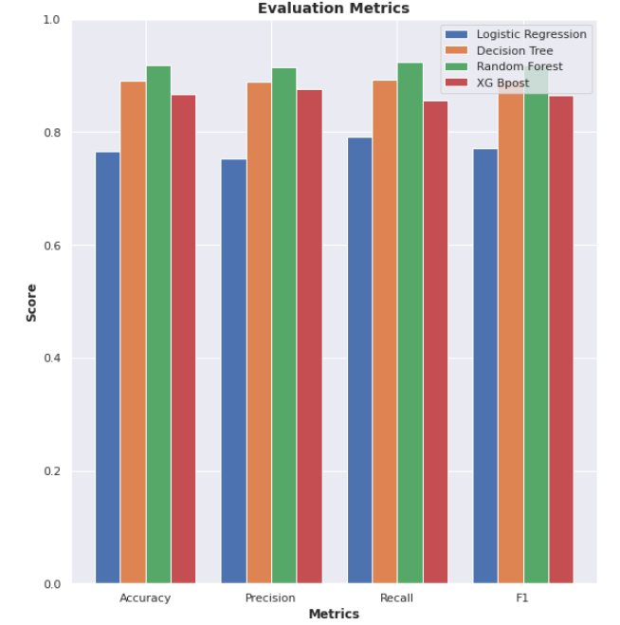
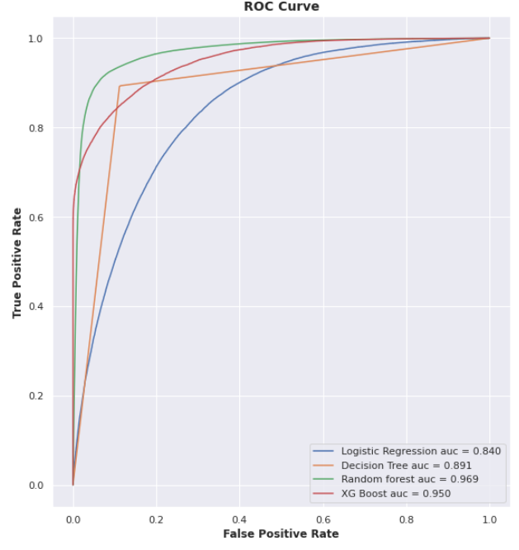
Modeling Recommendation
Random forest is the best and effective model.

Slide 13
Interpretation and Conclusion
BMI affects heart disease. Heart disease tends to be more likely to affect people with a BMI of 20 or above.
Reduce chances of having heart disease by doing physical activity and eating healthy food.
Smoking causes heart disease, among other things. Contrary to popular belief, the data indicates that alcohol consumption does not increase the risk of heart disease.
Heart disease is influenced by the number of physical health issues faced throughout the previous 30 days.
Stroke contributes to heart disease.
Heart disease is more likely to affect those who have trouble walking.
Men typically have a larger risk of developing heart disease than women.
Heart disease is influenced by asthma, skin cancer, and diabetes. Asthma, however, only makes a minor impact.

Slide 14
Future Recommendation
People should routinely have their heart checkup. Annual checkups should include a heart disease screening.
Doctors should emphasise the importance of a good diet and exercise for controlling blood sugar and cholesterol levels.
Smoking and binge drinking should be avoided because they both increase the risk of heart disease.
Heart attack survivors should have routine screenings to look for any abnormalities that could be signs of heart disease.

Slide 15

THANK YOU!

